Slide 1



Interfaces and Abstraction
Java OOP
Advanced
SoftUni Team
Technical Trainers
Software University
http://softuni.bg

Slide 2

Table of Contents
Abstraction
Abstract Classes
Interfaces

Slide 3
Questions
sli.do #3153

Slide 4

Abstraction

Slide 5
Abstraction
Ignoring irrelevant features
... relevant to the project we develop
With an eye to future reuse in similar projects
Abstraction helps managing complexity
Notes:
Abstraction means ignoring irrelevant features, properties, or functions and emphasizing the relevant ones, relevant to the project we develop.
Abstraction helps managing complexity
Abstraction is something we do every day:
Looking at an object, we see those things that have meaning to us and ignore all others.
Represent a complex reality with a simplified model.
In a bank application, customers have:
name, phone and address, but they don’t have :
hair color and favorite drink, which we are disregarded from.

Slide 6
Abstraction in OOP
How do we achieve abstraction?
Notes:
There are two ways to achieve abstraction
- Using Abstract Classes
- Using Interfaces

Slide 7

Abstract Class
Notes:
Abstract classes are partially defined classes. They represent some abstraction, not particular class, also they
- Mix between class and interface
- Can be partially implemented or fully unimplemented.
Not implemented methods are declared as abstract.
Abstract classes cannot be directly instantiated, and their child classes, should implement all abstract methods or they should be declared as abstract as well.

Slide 8
Abstract Method
public abstract class Animal { abstract void eat(); }
Notes:
Abstract methods are empty methods without implementation.
The implementation is intentionally left for the descendent classes.
When a class contains at least one abstract method, it should be defined as abstract.
Abstract classes model abstract concepts (e.g. person, object, item, movable object).
Concrete classes model concrete objects (e.g. dog, cat, frog, kitten).

Slide 9

Interface
Notes:
An interface defines a set of operations (methods) that a given object should support. Also called "contract" for providing a set of operations
Defines abstract behavior, abstract capabilities
Interfaces provide abstractions
- You invoke the abstract action
- Without worrying how it is implemented internally
- Without worrying what is the actual class which calls it

Slide 10
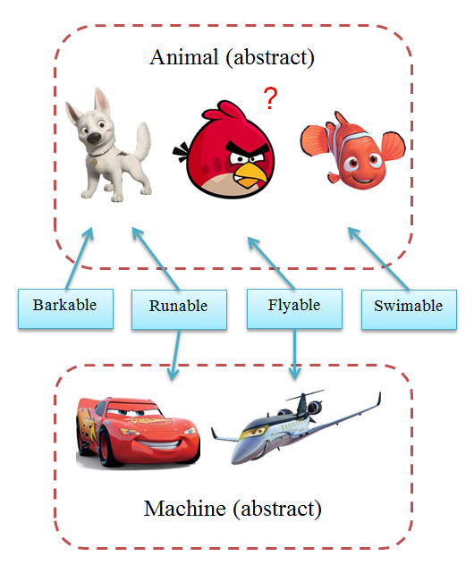
Example
Classes
Interfaces
Classes
Notes:
Interfaces in Java describe a prototype of group of methods (operations), properties and events. By interfaces :
- Can be implemented by a class or structure
- Define only the signature of the methods / properties
- No concrete implementations are provided
- Can be used to define abstract data types
- Can be extended by other interfaces
- Cannot be instantiated

Slide 11
Implementation
class SampleClass implements Interface

Slide 12
Implementation Example
interface Walkable { int getLegsCount(); void Walk(int distance); } class Dog implements Walkable { private int legsCount = 4; public int getLegsCount(){ return this.legsCount; }
public void Walk(int distance){}; }

Slide 13
Inheritance
interface Calculatable extends Printable

Slide 14
Interface inheritance Example
interface Drawable { int X = 0; int Y = 0; void Draw(); } interface Fillable extends Drawable { void Fill(); }

Slide 15
Implementing Constants
public interface Printable { int X_COORD = 0; void print(); }

Slide 16

Conventions
Notes:
Naming pattern: [Verb] + "able"
Examples:
- Movable
- AreaCalculatable

Slide 17

Interface Segregation

Slide 18

Demo

Slide 19

Exercises in Class

Slide 20
Interfaces vs. Abstract Classes
Interfaces
vs.
Abstract Classes
Notes:
Java interfaces are like purely abstract classes, but:
- All interface methods are abstract
- Interface members do not have scope modifiers
- Their scope is assumed public
- But public is not specified explicitly
- Cannot define fields, inner types and constructors

Slide 21

Abstract Data Types
Notes:
Examples:
- Stack
- Linked List
- Query
- Double Linked Query

Slide 22

Summary
Abstraction
Abstract Classes
Interfaces
Notes:
Abstraction :
Models class behavior
Interfaces :
Define a set of methods (contracts)
Abstract classes :
Mixes between class and interface

Slide 23









Interfaces and Abstraction
https://softuni.bg/java-advanced-oop

Slide 24

License
This course (slides, examples, demos, videos, homework, etc.) is licensed under the "Creative Commons Attribution-NonCommercial-ShareAlike 4.0 International" license
Attribution: this work may contain portions from
"Fundamentals of Computer Programming with Java" book by Svetlin Nakov & Co. under CC-BY-SA license
"OOP" course by Telerik Academy under CC-BY-NC-SA license

Slide 25






Free Trainings @ Software University
Software University Foundation – softuni.org
Software University – High-Quality Education, Profession and Job for Software Developers
softuni.bg
Software University @ Facebook
facebook.com/SoftwareUniversity
Software University @ YouTube
youtube.com/SoftwareUniversity
Software University Forums – forum.softuni.bg

